Slide 1
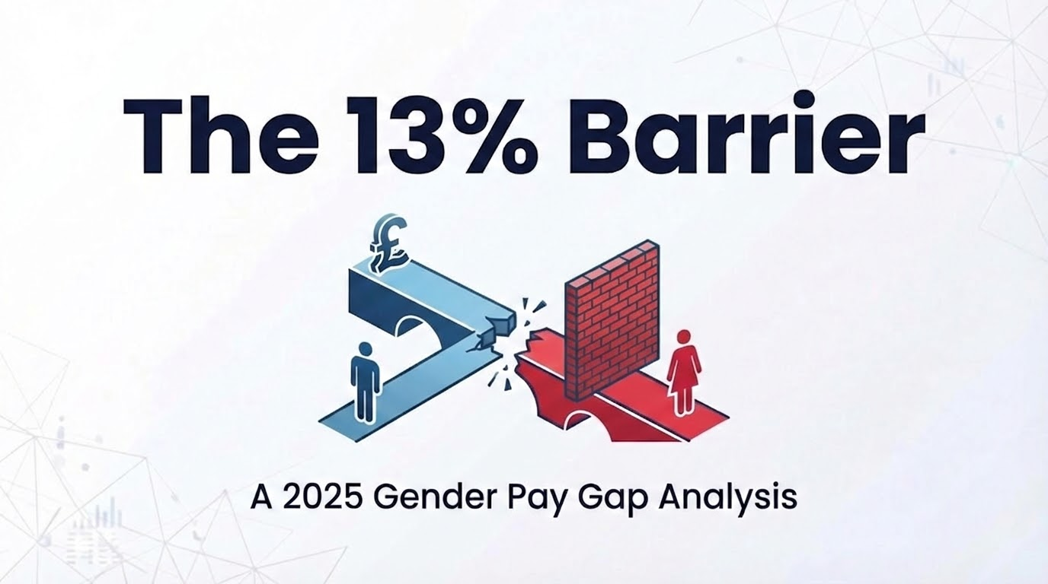
Notes:
"Good morning everyone. Thank you for this opportunity to present today.
[EYE CONTACT] Over the next eleven minutes, I'm going to share findings from an analysis of over ten thousand UK organizations. [PAUSE 2s]
What we discovered is that the gender pay gap is not primarily a compensation problem—it's a leadership access problem. And the real barrier is one-point-five times worse than the headline pay gap numbers suggest.
This is what we call 'The Thirteen Percent Barrier.'
Let me show you the evidence."

Slide 2
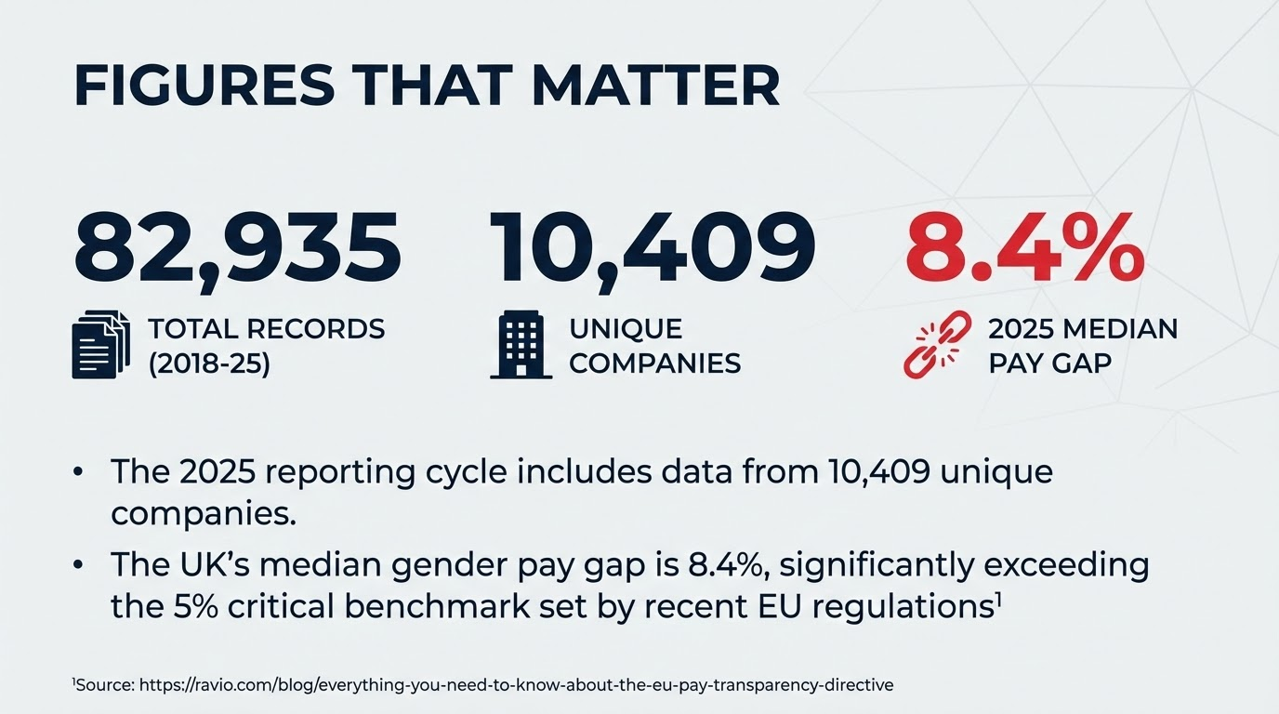
Notes:
"First, let me establish the scale of this analysis.
We examined eighty-two thousand, nine hundred and thirty-five records spanning twenty-eighteen to twenty-twenty-five, covering ten thousand, four hundred and nine unique companies reporting in the twenty-twenty-five submission year.
[GESTURE to screen] The UK's current median gender pay gap stands at eight-point-four percent. For context, recent European Union regulations have established five percent as the critical threshold requiring mandatory intervention. [PAUSE 2s] The UK currently exceeds this threshold by sixty-eight percent.
But here's what's critical: this eight-point-four percent pay gap? [PAUSE 2s] It's a symptom, not the root cause.
The real question is why women aren't reaching the highest levels in the first place."

Slide 3
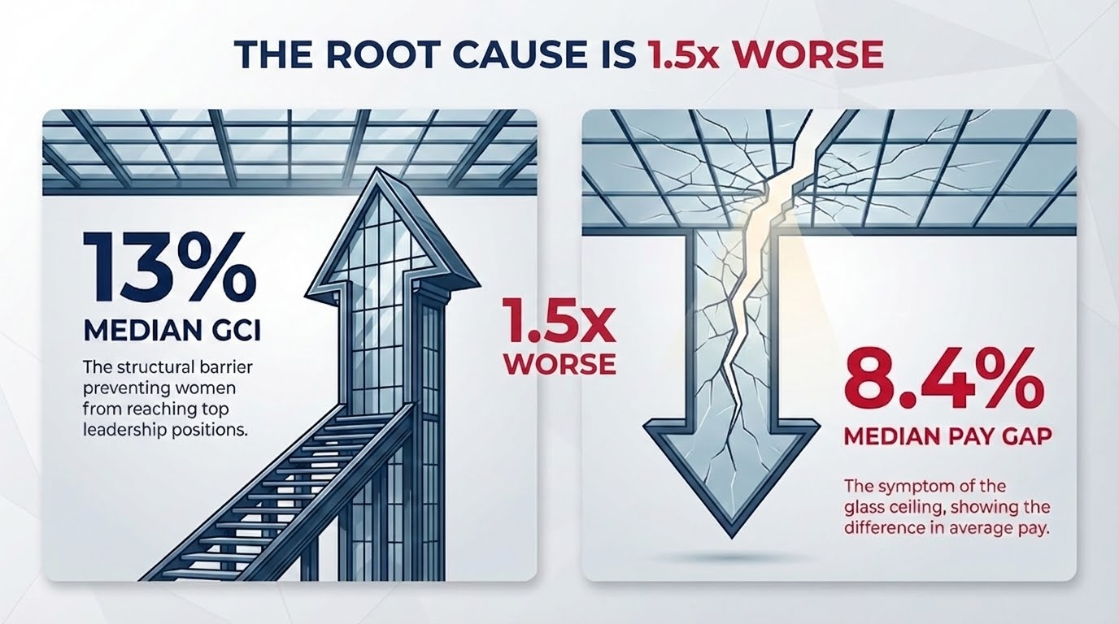
PAY GAP IS MERELY THE SYMPTOM…
The real structural problem is the
INVISIBLE GLASS CEILING
Notes:
"This is the fundamental insight of our research: the pay gap is merely the symptom—the invisible glass ceiling is the structural cause. 3s pause
Traditional analysis measures compensation differences and stops there. This fails to diagnose why these differences exist.
We introduce the Glass Ceiling Index—a measure of how effectively organizations block women from reaching top-quartile positions. The median GCI is 13%. That's 1.5 times worse than the pay gap itself.
Think about the implications. Even if we achieved perfect pay equality within every organizational tier tomorrow—equal pay for equal work at every level—the overall pay gap would persist. Why? Because women would still be systematically excluded from the highest-paying leadership positions where compensation is greatest.
The glass ceiling creates the pay gap. Not the other way around.
This is why decades of equal pay advocacy have produced slow progress. We've been treating the symptom while the structural barrier remains intact."
Transition: "Let me define exactly how we measure this barrier."

Slide 4
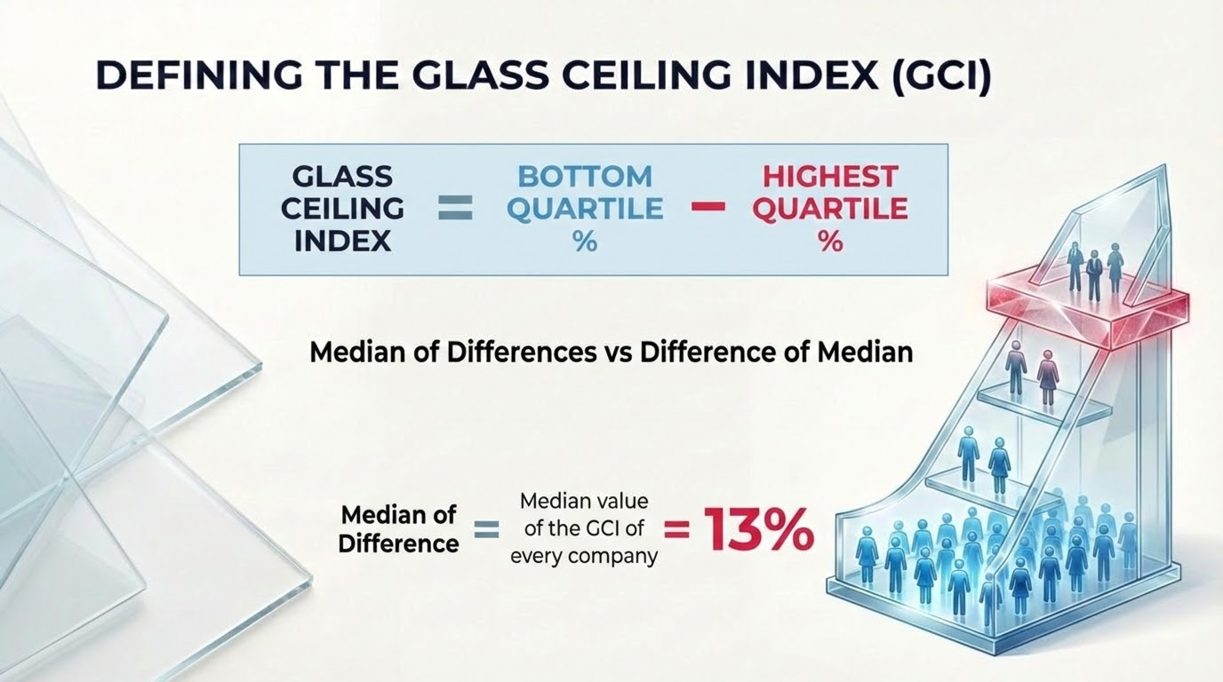
Notes:
"So let me define precisely how we measure this glass ceiling phenomenon.
The Glass Ceiling Index is calculated as the percentage of women in the bottom quartile of an organization, minus the percentage of women in the highest quartile.
Here's a concrete example. [GESTURE] If an organization employs women at sixty percent of its lowest-paid positions, but only forty percent of its highest-paid positions, the Glass Ceiling Index is twenty percent. This represents a twenty-percentage-point representation gap between entry-level and leadership positions.
Now, methodologically, we calculate the median of differences rather than the difference of medians. This approach captures the typical organizational experience rather than being distorted by extreme outliers.
So that median GCI of thirteen percent represents the midpoint—half of organizations have a larger barrier, half have a smaller one."

Slide 5
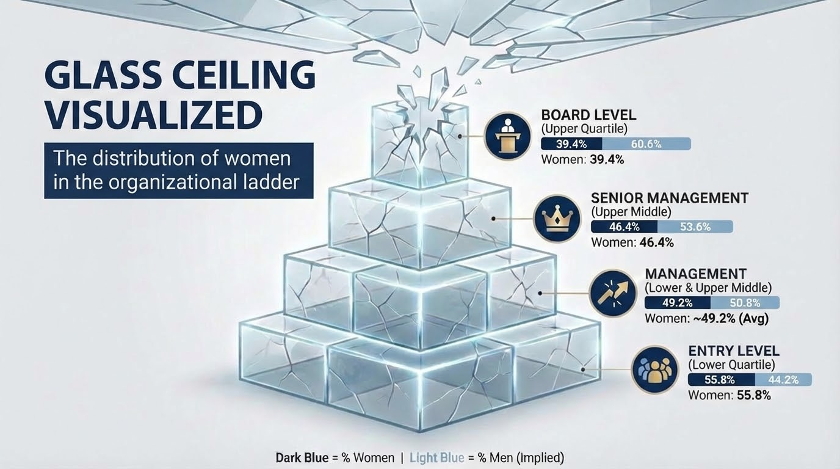
Notes:
"When we visualize this glass ceiling across organizational hierarchies, the pattern becomes unmistakable.
[GESTURE to pyramid] Look at this pyramid. This shows women's representation across organizational levels in UK companies.
At the entry level—represented by the bottom quartile—women constitute fifty-five-point-eight percent of the workforce. [PAUSE 2s] That's above parity. This reflects current educational trends where women now earn the majority of university degrees in the UK.
But watch what happens as we move up.
At the management level—combining lower and upper middle quartiles—women's representation drops to forty-nine-point-two percent. We've now fallen slightly below parity.
At the senior management level—the upper middle quartile—women hold forty-six-point-four percent of positions. The gap continues to widen.
And at the board and executive level—the top quartile—women's representation falls to just thirty-nine-point-four percent. [PAUSE 3s]
From entry to executive, that's a [EMPHASIS] sixteen-point-four percentage-point decline.
Let me be precise about what this means. For every one hundred women entering at the bottom, only seventy make it proportionally to the top. Thirty who should be there statistically—aren't.
[EYE CONTACT] This is not a recruitment problem. This is not a pipeline problem. This is not women choosing to opt out. [PAUSE 2s] [EMPHASIS] This is a systematic retention and promotion barrier at every level of advancement."

Slide 6
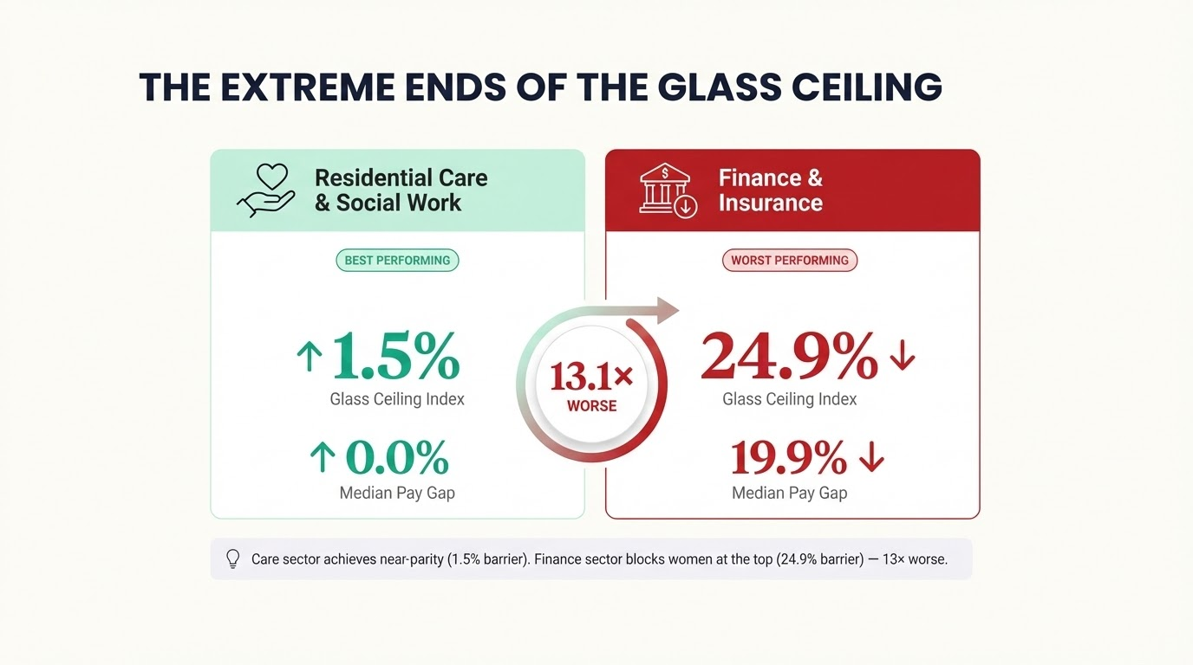
Notes:
"Now, not all sectors create equal barriers. And the variation tells us something crucial.
[GESTURE to left side] On one end, we have the Residential Care and Social Work sector. This sector has achieved near-parity with a Glass Ceiling Index of just one-point-five percent. Their median hourly pay gap is zero-point-zero percent—essentially non-existent.
[GESTURE to right side] On the complete opposite end, we have Finance and Insurance—with a Glass Ceiling Index of twenty-four-point-nine percent and a median pay gap of nineteen-point-nine percent.
Think about this. [PAUSE 2s] The finance sector's glass ceiling is [EMPHASIS] thirteen-point-one times worse than the care sector's. In finance, one in four leadership positions that women would statistically hold under equal conditions is instead held by men due to structural barriers.
Here's why this matters for policy. [EYE CONTACT] Both sectors require highly skilled professionals. Both require substantial education and expertise. The difference isn't in the work—it's in organizational culture, promotion practices, and systemic design choices.
The care sector proves parity is achievable. Finance proves that barriers are constructed, not natural."

Slide 7
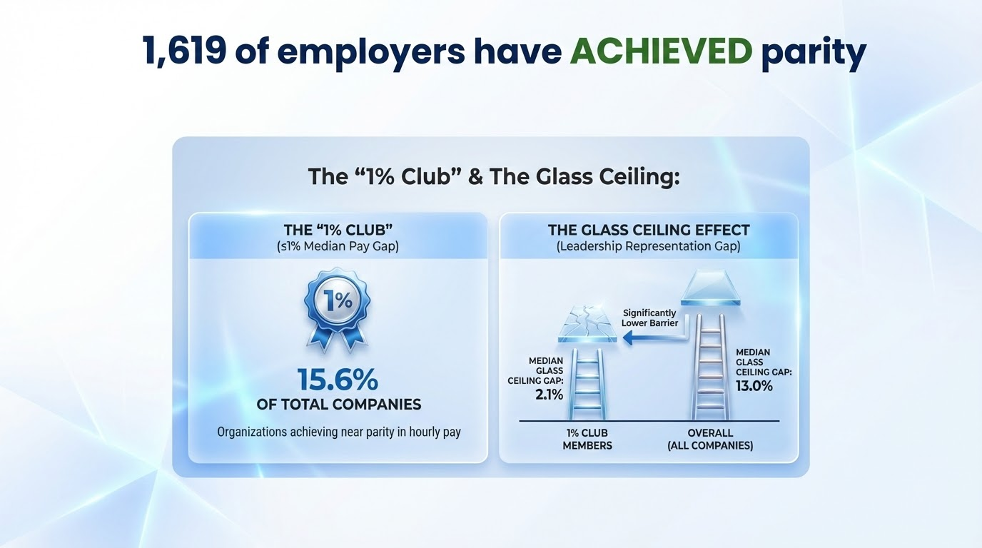
Notes:
"Beyond sector-level patterns, we can also identify specific organizations that have achieved exemplary performance.
One thousand, six hundred and nineteen employers—representing fifteen-point-six percent of all reporting companies—have achieved what we designate as 'One Percent Club' status. These organizations maintain a median pay gap at or below one percent, representing functional pay parity.
However, here's a crucial finding: even these exemplary organizations that have mastered equal pay still face a glass ceiling challenge. Their median Glass Ceiling Index stands at two-point-one percent. [PAUSE 2s]
But notably, the One Percent Club's glass ceiling barrier is [EMPHASIS] eighty-four percent smaller than the typical organization.
Organizations committed to equity comprehensively tend to address both compensation and promotion barriers simultaneously. These organizations are our proof of concept."

Slide 8
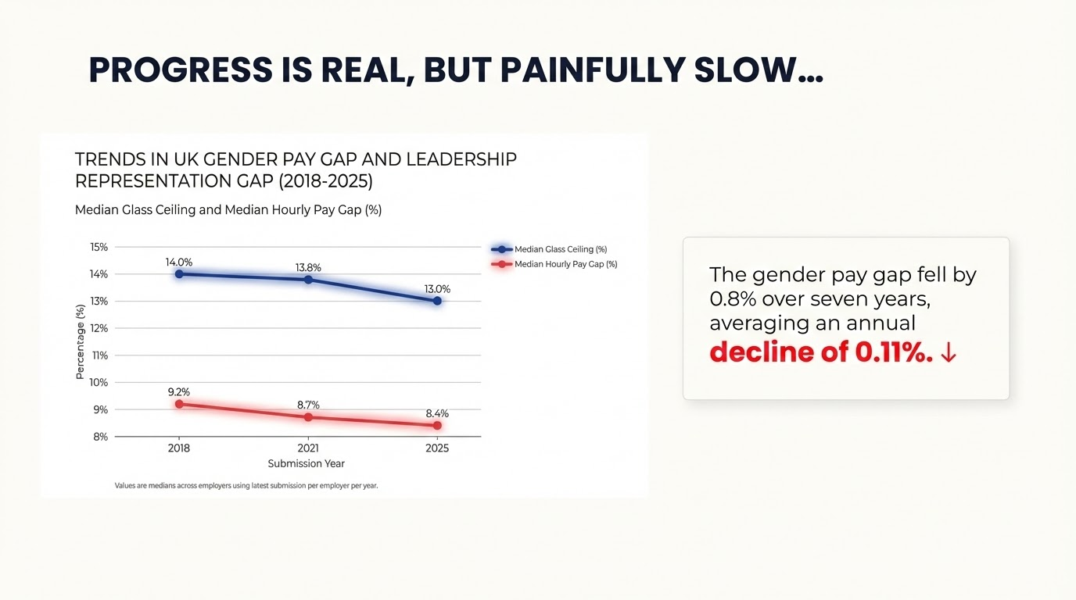
Notes:
"So having established that parity is possible, we must now confront an uncomfortable question: at what pace are we currently progressing toward that goal?
[GESTURE to chart] This slide presents longitudinal trend analysis spanning twenty-eighteen to twenty-twenty-five—seven years.
The data confirms that progress is real. The median Glass Ceiling Index has declined from fourteen-point-zero percent to thirteen-point-zero percent. The median hourly pay gap has decreased from nine-point-two percent to eight-point-four percent.
We must acknowledge these improvements. Organizations are taking this seriously. [PAUSE 2s]
However, here's the sobering reality. The average annual rate of improvement is zero-point-one-one percentage points per year.

Slide 9
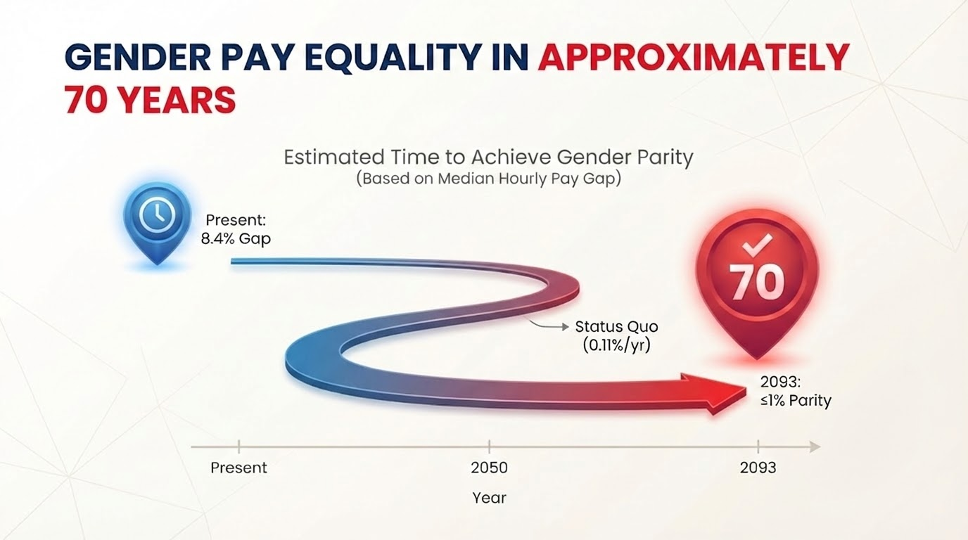
Notes:
"Let me visualize this timeline to make its implications fully apparent.
[EYE CONTACT] At this pace, assuming no acceleration, the UK would reach pay parity in the year [EMPHASIS] twenty-ninety-three. [PAUSE 3s]
That is sixty-eight years from today. [PAUSE 2s]
If you're under fifty-five, you will not see gender pay equality in your career. In many cases, your daughters won't see it in theirs either.
Voluntary reporting and incremental cultural change are insufficient."
The visualization speaks for itself. [PAUSE 2s] This is the cost of inaction.
But we have solutions."

Slide 10
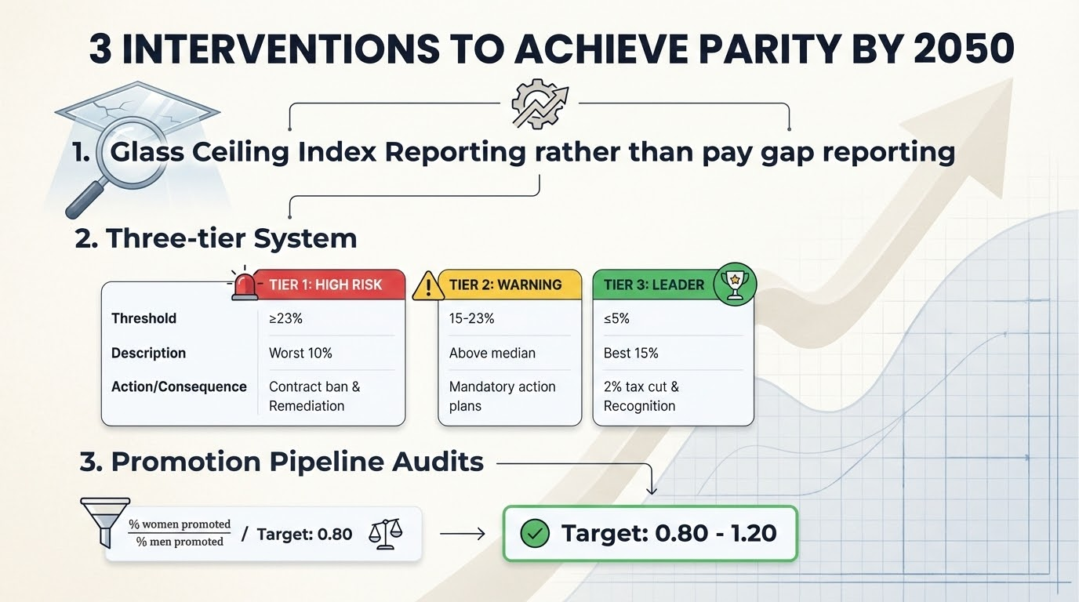
Notes:
"Based on this comprehensive analysis, I propose three evidence-based policy interventions designed to achieve parity by twenty-fifty—cutting the timeline from seventy years to twenty-five years.
[GESTURE - hold up one finger] First: Mandate Glass Ceiling Index reporting alongside pay gap reporting.
Organizations should be required to report their GCI using the methodology I've just described. What gets measured gets managed. Current pay gap reporting has increased awareness, but it does not directly measure the promotion barrier. GCI reporting would provide transparency into the actual bottleneck preventing women from reaching leadership.
[GESTURE - hold up two fingers] Second: Implement a three-tier accountability system.
This system classifies organizations into three tiers based on their Glass Ceiling Index.
Tier Three—Leaders with a GCI under five percent: These organizations receive a two percent corporate tax reduction and public recognition. This rewards excellence.
Tier Two—Warning with a GCI between fifteen and twenty-three percent—above the median: These organizations must submit mandatory action plans with annual progress reporting to regulatory authorities.
Tier One—High Risk with a GCI of twenty-three percent or higher—the worst-performing ten percent: These organizations face restrictions on government procurement contracts and must implement supervised remediation plans with external oversight.
This creates both carrots and sticks.
[GESTURE - hold up three fingers] Third: Mandate promotion pipeline audits.
Organizations must track and report the ratio of women promoted versus men promoted at each organizational level. The acceptable range is zero-point-eight-zero to one-point-two-zero—meaning women should be promoted at rates within twenty percent of men's rates.
[PAUSE 2s] These aren't theoretical. [EYE CONTACT] These are scaled versions of what the One Percent Club already does voluntarily."

Slide 11
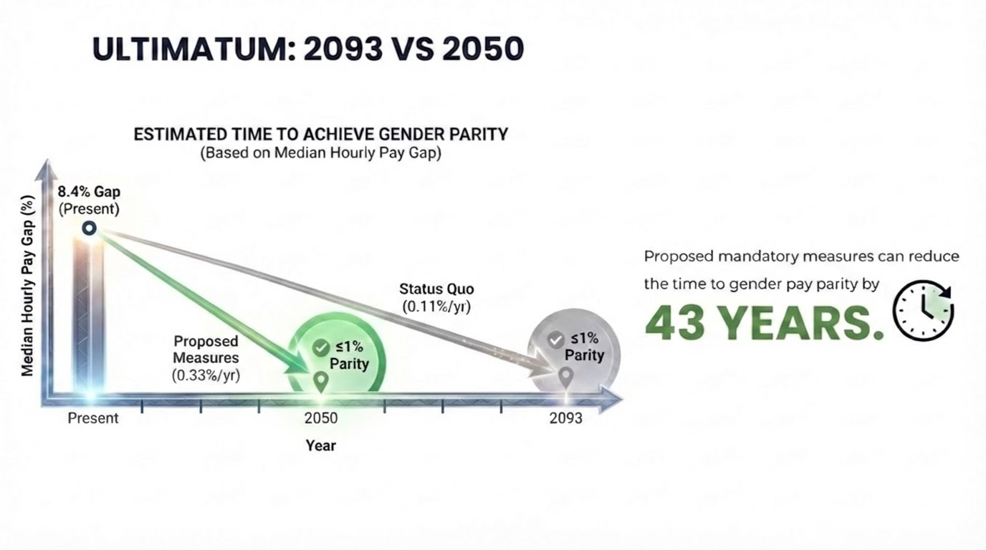
Notes:
"Let me now present the comparative timelines under these two scenarios.
[GESTURE to gray line] The gray trajectory represents the status quo: zero-point-one-one percent annual improvement, reaching parity in twenty-ninety-three. This is the path of voluntary measures, gradual cultural evolution, and hoping that organizational practices will slowly improve.
[GESTURE to green line] The green trajectory represents the accelerated path under our proposed interventions: zero-point-three-three percent annual improvement, reaching parity by twenty-fifty.
[PAUSE 2s]
This intervention reduces the timeline by [EMPHASIS] forty-three years.
Women entering the workforce today would experience pay parity before retirement. The next generation would inherit equity, not inequality.
[EYE CONTACT] I emphasize: this is not speculative. This zero-point-three-three percent rate is modeled on the actual performance of the fifteen-point-six percent of organizations currently in the One Percent Club.
We are not proposing the impossible. We are proposing that best practices become universal standards.
The question is not capability—we have proven capability. The question is commitment."

Slide 12
THANK YOU
Notes:
"To conclude.
[EYE CONTACT] The UK's gender pay gap is not primarily a compensation problem. It is a leadership access problem.
The eight-point-four percent pay gap is the symptom. The thirteen percent glass ceiling is the structural cause.
Without intervention: twenty-ninety-three. With intervention: twenty-fifty.
We have the data. We have the evidence. We have the solutions. [PAUSE 2s]
What remains is the decision to act.
[PAUSE 2s]
Thank you.

